Slide 1



Welspun Corporation
Fiber Manufacturing Process Optimization
Decision Intelligence at scale to unlock Latent Potential of each Plant
Date: 27th Aug, 2026
www.faclon.com

Slide 2
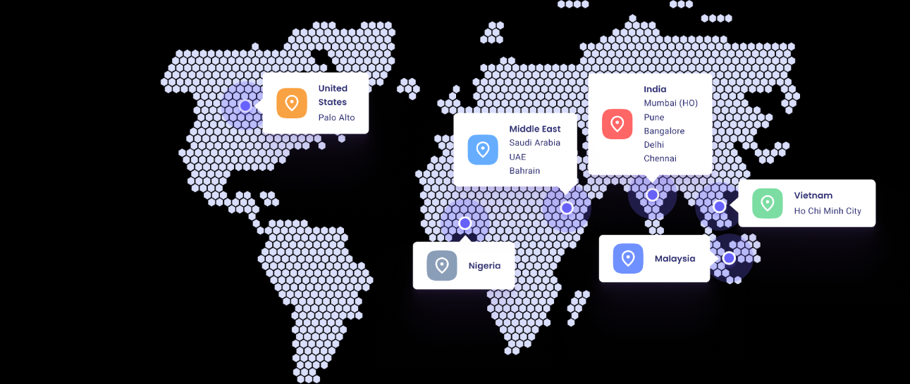

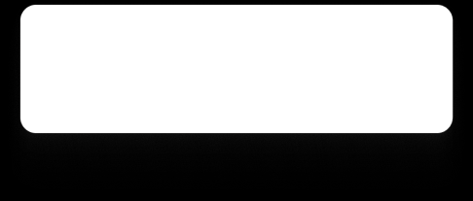
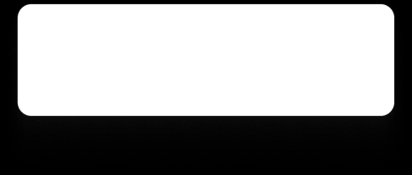


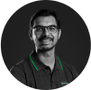

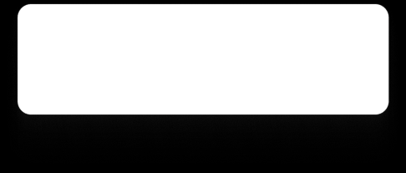

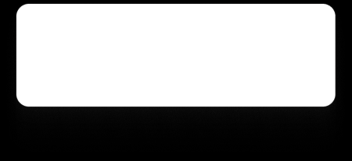
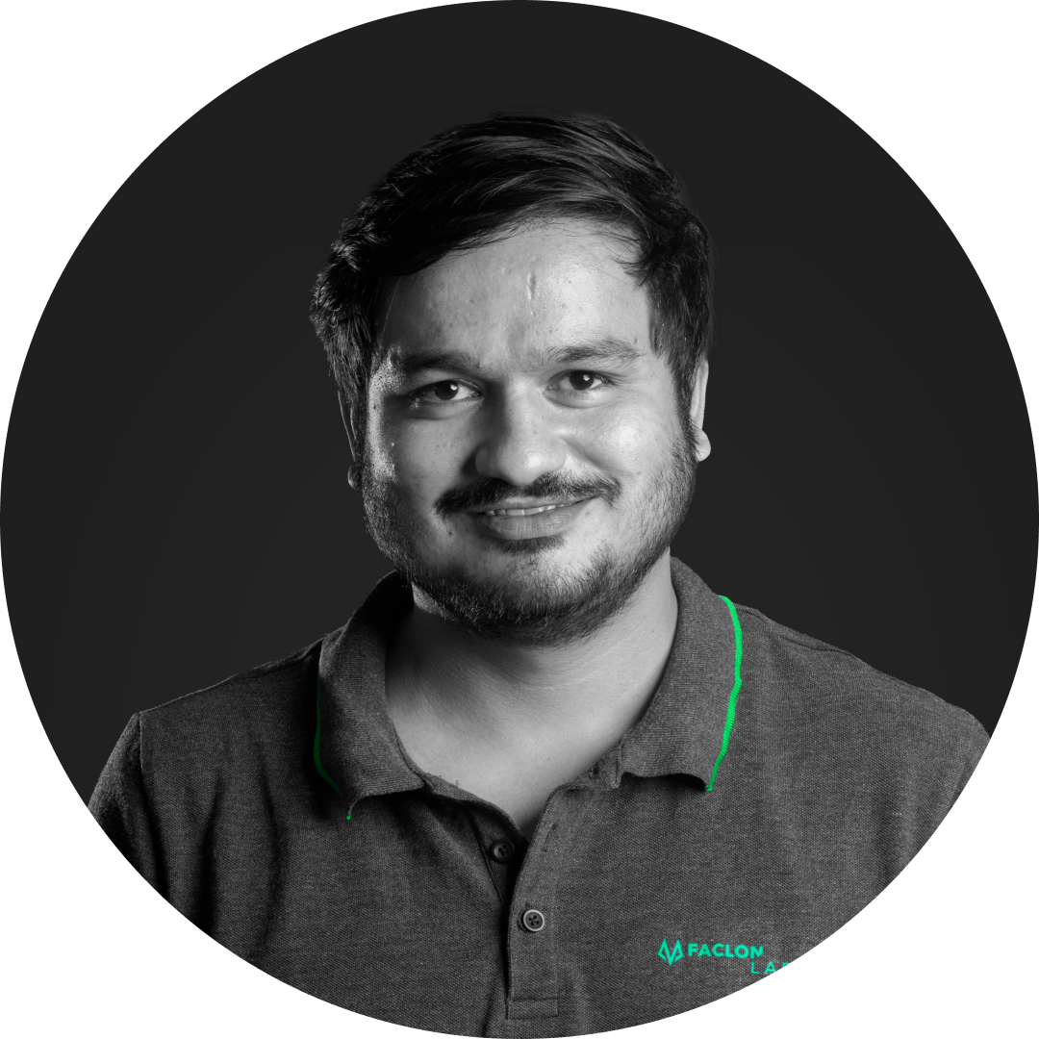


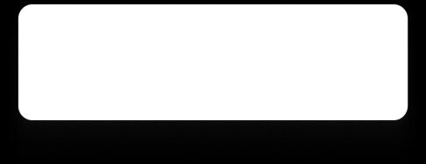
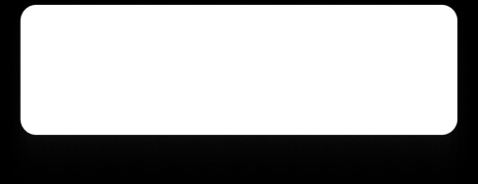
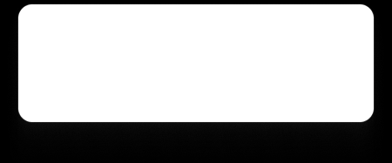

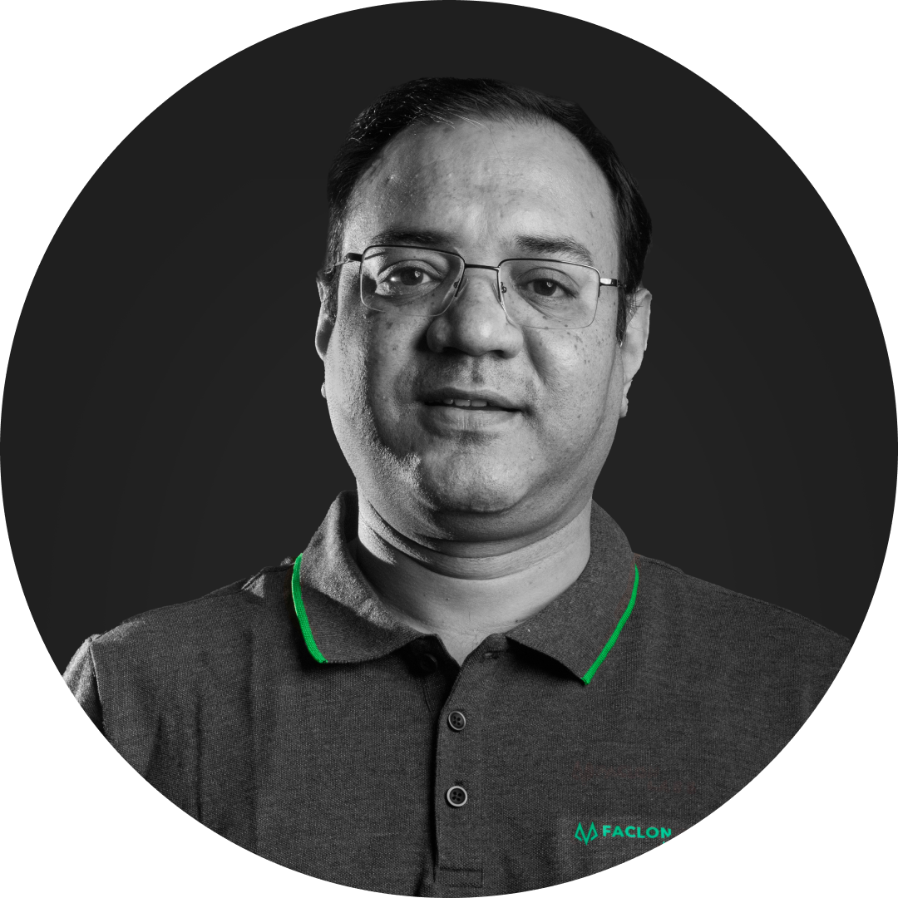




Faclon Labs at a Glance
Leaders in Industrial Data Integration, Visualization, and AI based Optimization
183+
Customers
400+ Deployments
60k+
Assets Connected
5 B+
Data Points Daily
150+
Employees
Rishi Sharma​
Utkarsh Srivastava​
CEO
CTO
B.Tech IIT Bombay
Ex-White Hat Hacker
Backed By
Parth Chaudhary
Vivek Singh​
Sarjan Shah
President of Solution
Chief Data Scientist​
MD, Group Satellite
B. Tech IIT Bombay
B.Tech IIT Kanpur
Archit Naraniwal​
Parag Patil
Jay Kotak
Siddharth Mehra
Chief Sales Officer
Chief Strategic Alliances
B. Tech IIT Bombay
Ex-Wipro, Infosys, RIL
Co-head, Kotak 811
ED, Savita Oil
‹#›

Slide 3









































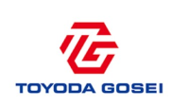




























Key Customers
Trusted and Ideal digital partner for Industrial setups, commercial setups and OEMs
Automobile &
ancillary
Consumer
Goods
Metals
Cement
Consumer Durables
Chemicals
Energy, Oil & Gas
Pharma
Commercial Infra
OEM tie
-
ups
Partnerships
‹#›

